Slide 1

Smart Cloud Management System: Revolutionising Cloud Operations

Slide 2

Introduction: The Cloud Complexity Challenge
Public / Private / Hybrid
Cloud adoption is accelerating globally, with enterprises increasingly utilising multiple cloud providers and hybrid environments. This rapid expansion, while beneficial, introduces significant challenges.
Siloed Policies
Centralized Controls
Consistent Governance
Managing these diverse and fragmented environments manually leads to considerable inefficiencies, heightened security risks, and escalating operational costs. A unified approach is critically needed.
Cross‑Cloud Visibility
Fragmented Clouds
Unified Management

Slide 3

Problem Statement: Fragmented Cloud Management
Lack of Unified Visibility
Across public, private, and hybrid clouds, leading to operational blind spots.
Manual Provisioning
Causing significant delays and an increased propensity for human errors.
Inconsistent Policies
Difficulty enforcing security and compliance policies uniformly across diverse environments.
Rising Costs
Due to inefficient resource utilisation and lack of proper cost governance.
Real-world impact: According to Gartner (2025), 70% of organisations cite cloud management complexity as a primary barrier to achieving their cloud objectives.

Slide 4
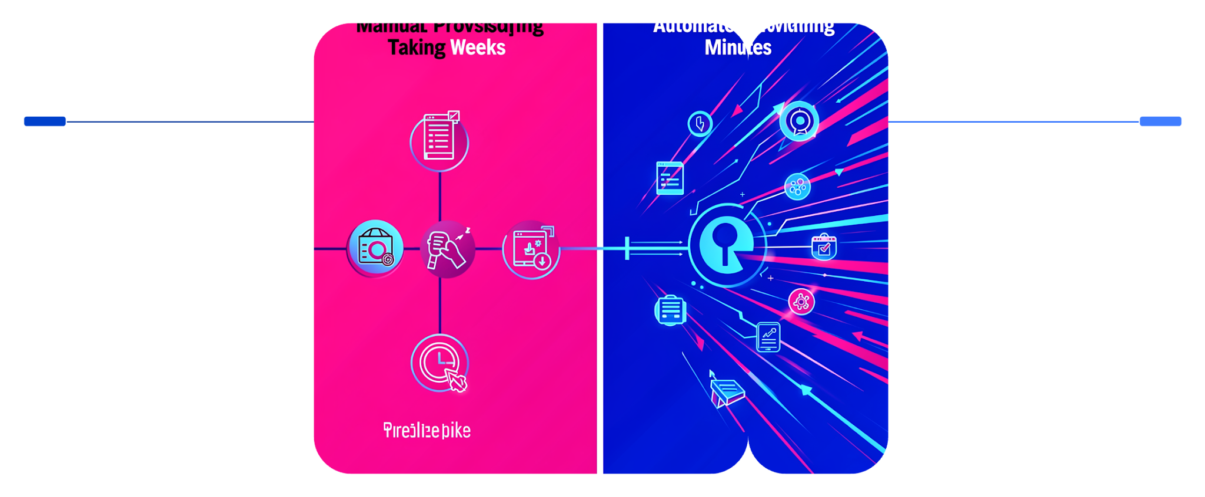
Solution Overview: Smart Cloud Management System
Our Smart Cloud Management System provides a centralised, intelligent platform designed to automate provisioning, orchestration, monitoring, and governance across all your multi-cloud environments.
Manual Provisioning
Automated Provisioning
It offers intuitive self-service portals, policy-driven automation, and real-time analytics to streamline operations and enhance control.
Took weeks with repetitive, error-prone steps
Completes in minutes with consistent policies
Example: IBM SmartCloud Orchestrator has demonstrated the ability to reduce provisioning time from weeks to mere minutes through automated workflows.

Slide 5
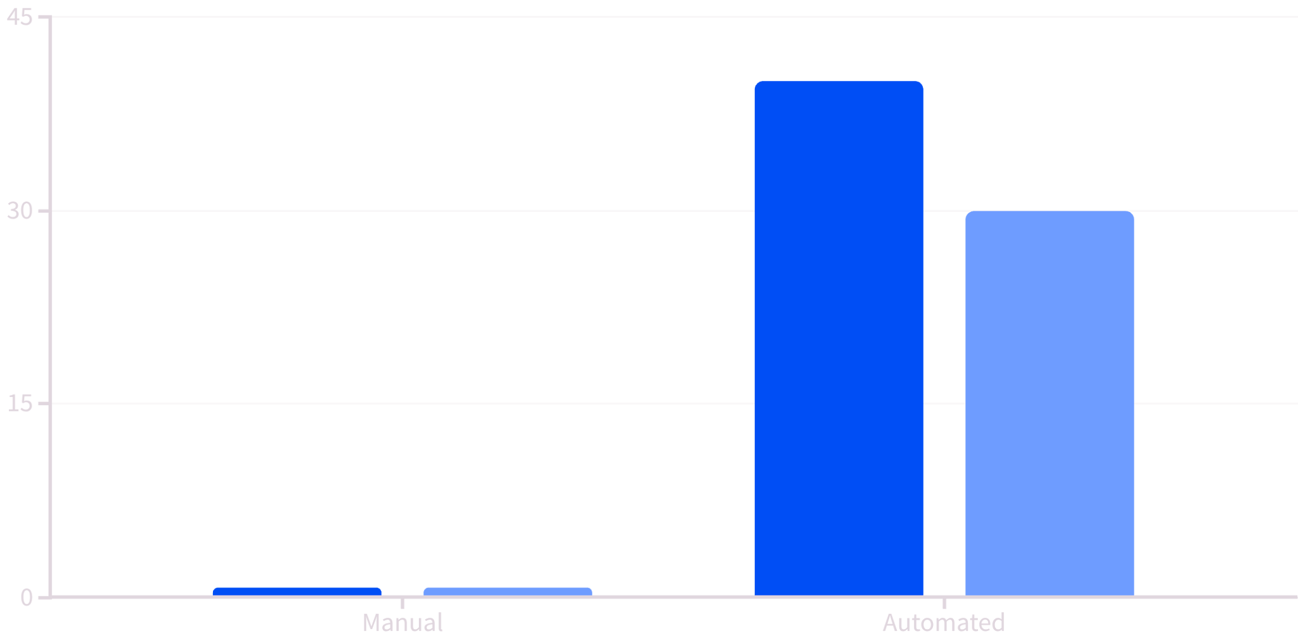
Literature Review: Advances in Cloud Orchestration
Key studies consistently highlight the transformative benefits of robust cloud orchestration solutions:
IBM’s SmartCloud Orchestrator exemplifies how integrating compute, storage, and network domains can achieve seamless automation.
Research indicates that comprehensive automation can reduce human error by up to 40% and significantly decrease operational costs by 30%.
The adoption of open platforms is crucial, enabling flexible integration with diverse cloud providers and fostering greater agility.
Error Reduction (%)
Cost Reduction (%)

Slide 6





Technologies Used: Core Components
Cloud Orchestration Engines
Automate deployment and lifecycle management of cloud resources (e.g., IBM Cloud Orchestrator).
Containerisation & Microservices
Enable scalable, modular applications for flexible cloud deployment (Docker, Kubernetes).
AI & Analytics
For predictive resource optimisation, intelligent automation, and anomaly detection.
Security & Compliance Tools
Provide continuous monitoring and automated policy enforcement across all environments.

Slide 7
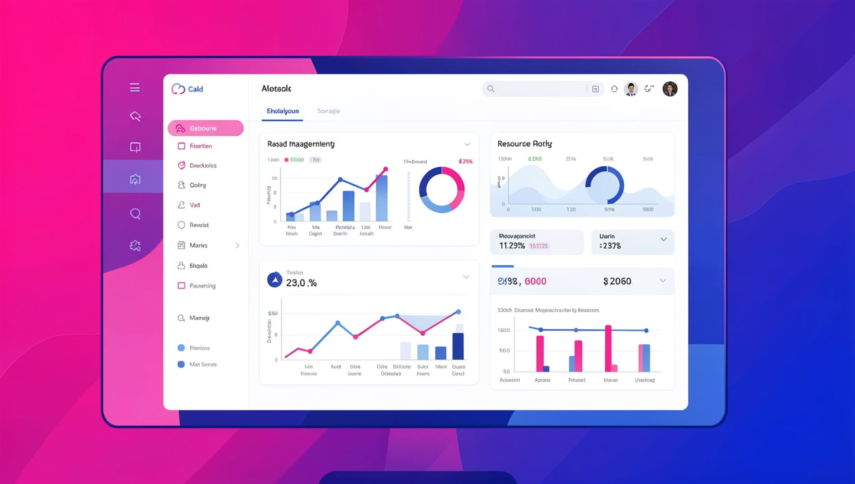
Technologies Used: Supporting Infrastructure
APIs and Open Standards: Essential for ensuring seamless interoperability between diverse cloud services and platforms.
Self-Service Portals: Empower users with on-demand, user-driven provisioning of resources, reducing IT bottlenecks.
Monitoring Dashboards: Provide real-time, comprehensive insights into cloud performance, usage, and health.
Automation Scripts & Templates: Facilitate repeatable, error-free workflows for consistent environment management.

Slide 8

Case Study Highlight: IBM Multicloud Management Platform
The IBM Multicloud Management Platform stands as a premier example of smart cloud management in action, offering a unified operations console for both traditional data centres and complex multicloud environments.
1
2
3
Workload Optimisation
Cost Management
Compliance Automation
Intelligent placement and balancing of workloads for peak performance and efficiency.
Advanced analytics and controls to reduce cloud spend and forecast expenditures accurately.
Automated enforcement and reporting to ensure continuous regulatory adherence.
Clients utilising the platform report remarkable improvements, including 50% faster deployment cycles and a significant 25% reduction in overall cloud expenditure.

Slide 9




Conclusion: Transforming Cloud Management for the Future
Essential for Success
Smart Cloud Management Systems are crucial for fully harnessing the potential benefits of cloud infrastructure.
Drive Efficiency
They effectively reduce complexity, improve agility, enhance security postures, and significantly optimise costs.
Gain Competitive Edge
Organisations that adopt these advanced systems gain a distinct competitive advantage in their digital transformation journeys.
Call to action: Embrace smart cloud management to unlock your cloud’s full potential and secure your future in the digital landscape.

Slide 10

Thank You
Questions & Discussion
Please feel free to ask any questions or share your thoughts.
Contact Information
For follow-up inquiries or demo requests, please reach out to [Your Name/Company Details].

